Slide 1
Drone Phenology Monitoring
Gaurav Rajput
Parth Thakur

Slide 2
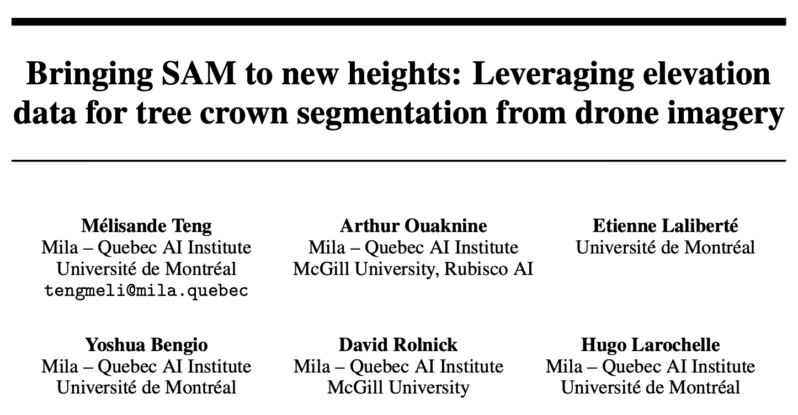
Research Paper Overview
Goal: Improve individual tree crown segmentation
Key Techniques:
Use of Segment Anything Model (SAM)
Integration of DSM (elevation) data for better segmentation

Slide 3
What is DSM?
DSM = Digital Surface Model
Provides height of surface including trees/buildings
Obtained using photogrammetry from RGB images
No need for LiDAR – can be derived from multi-angle drone imagery

Slide 4
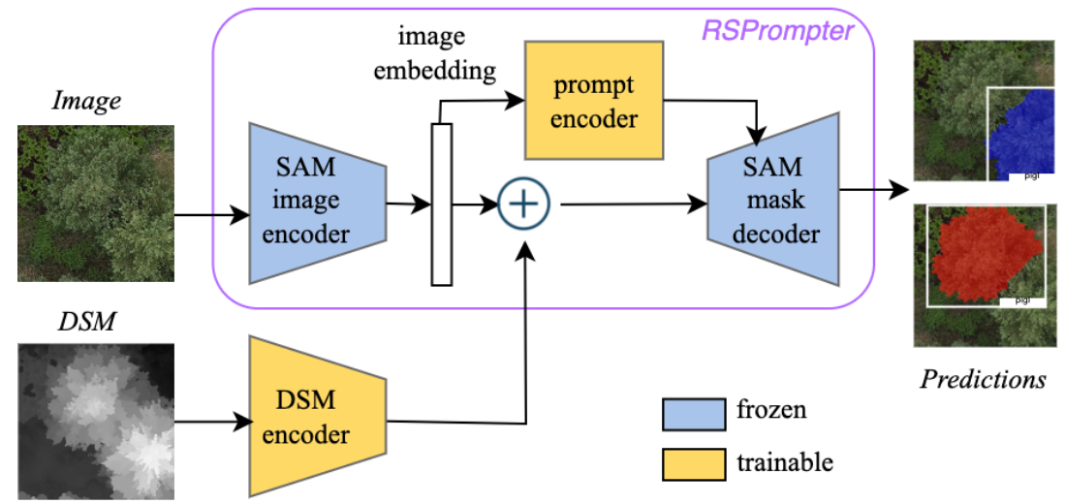
BalSAM – Proposed Method
Builds on RSPrompter
Uses a trainable DSM encoder to fuse elevation data with SAM inputs
Result: Better tree crown segmentation, especially in structured plantations

Slide 5
PerformanceMetrics
| Model | mAP (%) | mIoU (%) | wmAP (%) |
|---------------------- |---------|---------- |---------- |
| BalSAM | 65.03 | 83.24 | 64.84 |
| RSPrompter | 66.37 | 82.58 | 62.37 |
| Mask R-CNN + DSM | 64.64 | 81.89 | 60.32 |
| SAM (auto prompts) | 11.17 | 50.91 | – |

Slide 6
Challenges
Issue: No LiDAR → No direct DSM
Paper uses DSM for best results
My constraint: Only RGB images
Workaround: DSM can be made from multi-angle raw images, but:
Needs structured capture (nadir + oblique)

Slide 7
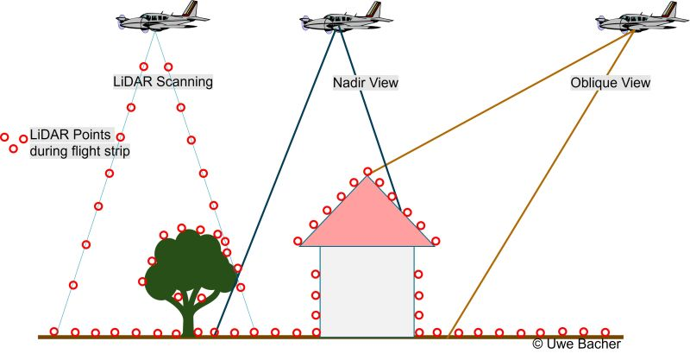

Slide 8
Way Forward
Option 1: Re-fly and capture raw nadir + oblique images, process via WebODM to generate DSM
Option 2: Continue with RGB-only approach using Detectree2

Slide 9
currently
I have also started working on Datastructure to store tree feature per crown detected,that is its mean colour, leaf density, species determination, in this i am thinking of implementing resnet 50 for leaf density and species determination as was used in the paper shared you

Slide 10
Thank You

